Slide 1
Dictionaries

Slide 2
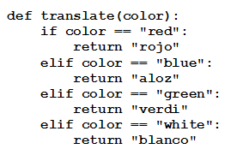
Dictionaries
Consider this function
A mini English-Spanish dictionary
A function of this type is called a mapping
Python has an efficient and flexible mapping device, called a dictionary
The value of translate["blue"] is "aloz"

Slide 3
Dictionaries
Python dictionary is defined as
A collection of comma separated pairs
Of the form ”key:value”
Enclosed in curly braces.
Value associated with key1 is given by the expression dictionaryName[key1].

Slide 4
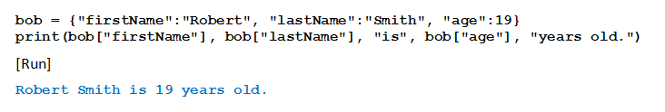
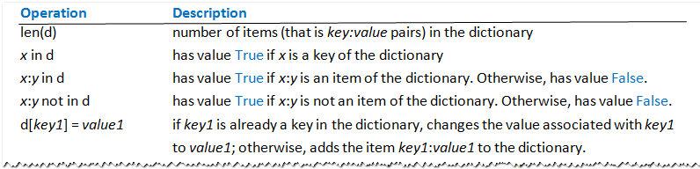
Dictionaries
Example
Table 5.4 Dictionary Operations

Slide 5
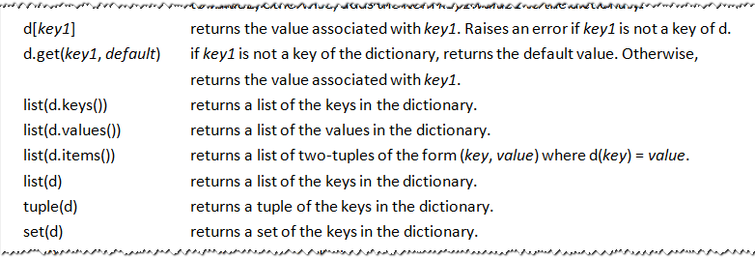
Dictionaries
Table 5.4 Dictionary Operations

Slide 6
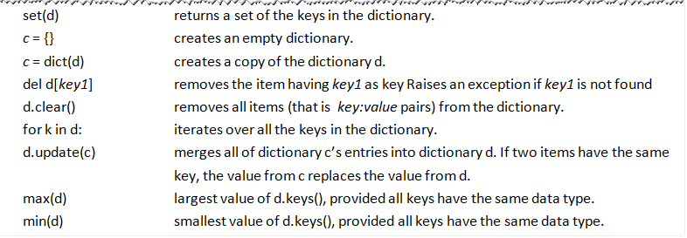
Dictionaries
Table 5.4 Dictionary Operations

Slide 7
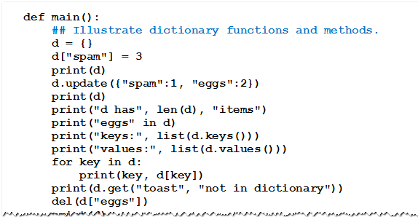
Dictionaries
Example 1: Program illustrates many of the functions and methods for dictionaries.

Slide 8
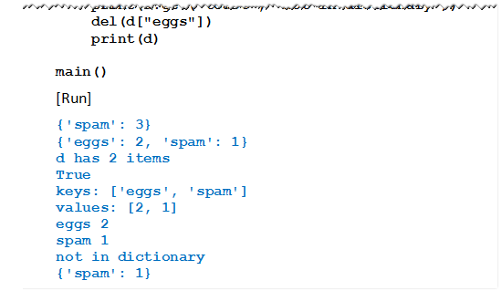
Dictionaries
Example 1: Program illustrates many of the functions and methods for dictionaries.

Slide 9
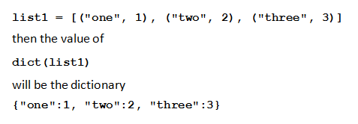
The dict Function
List of 2-item lists or 2-item tuples can be converted to a dictionary with dict function
Example

Slide 10
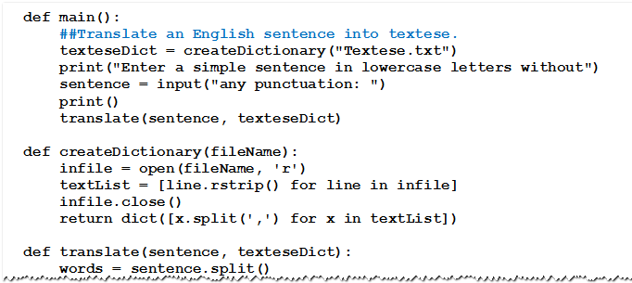
Creating a Dictionary from a Text File
Example 2: Program translates simple sentences into textese

Slide 11
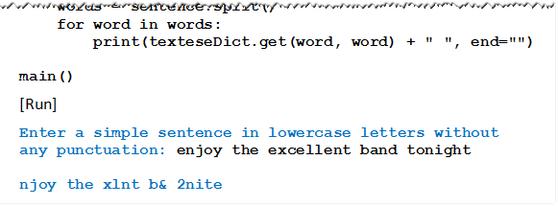
Creating a Dictionary from a Text File
Example 2: Program translates simple sentences into textese

Slide 12
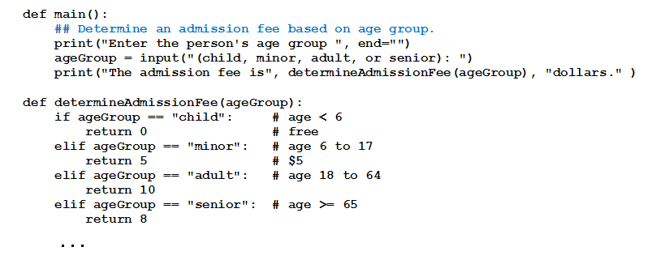

Creating a Dictionary from a Text File
Example 3: Program with long if-elif statement can be simplified with use of a dictionary.

Slide 13
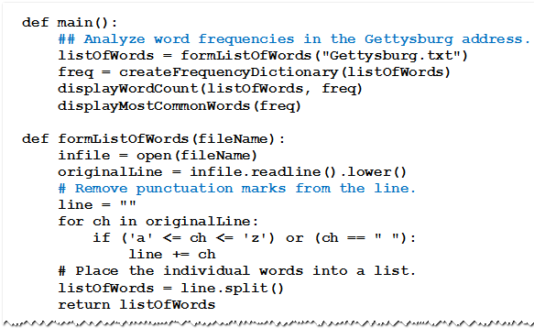
Using Dictionary as Frequency Table
Example 4: Program counts the number of words in the Gettysburg Address
Displays most frequently used words.

Slide 14
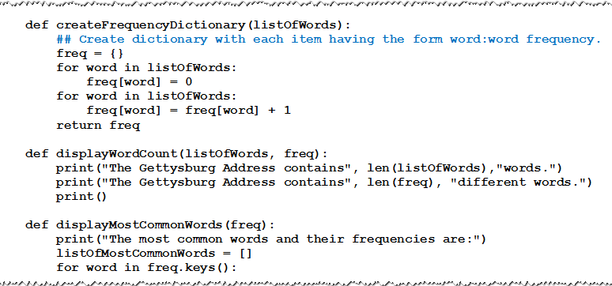
Using Dictionary as Frequency Table
Example 4

Slide 15
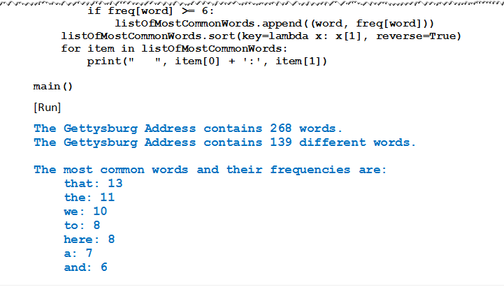
Using Dictionary as Frequency Table
Example 4

Slide 16
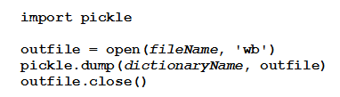
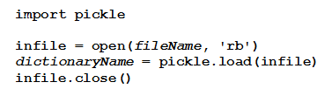
Creating Dictionary from Binary File
Binary format
Stores data as sequence of bytes
Can only be accessed by special readers
Methods that store dictionaries to, and retrieve dictionaries from binary files.
Must be imported from a module named pickle

Slide 17
Dictionary-Valued Dictionaries
Dictionary’s values can be any type of object
Including a dictionary
Consider this dictionary
Value of nations["Canada"] would be the dictionary

Slide 18
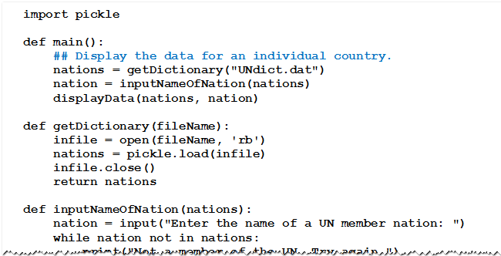
Dictionary-Valued Dictionaries
Example 5: Program displays the data for a requested nation

Slide 19
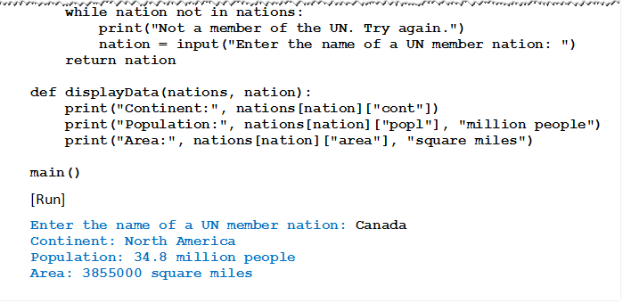
Dictionary-Valued Dictionaries
Example 5

Slide 20
Extracting Ordered Data from a Dictionary
A dictionary is an unordered structure
Does not have a sort method
However, items of dictionary can be placed into a list
As 2-tuples
In customized order
Use function of the form

Slide 21
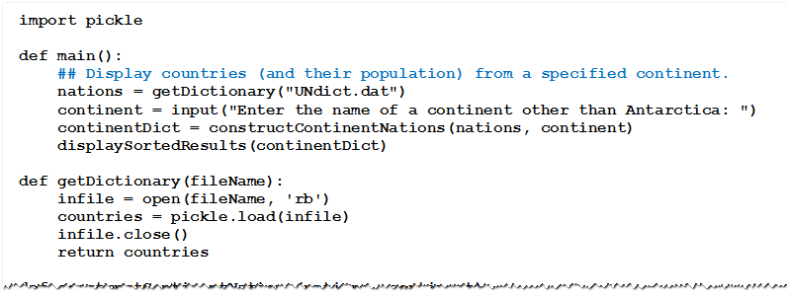
Extracting Ordered Data from a Dictionary
Example 6: Program displays UN member countries (and populations) from specified continent

Slide 22
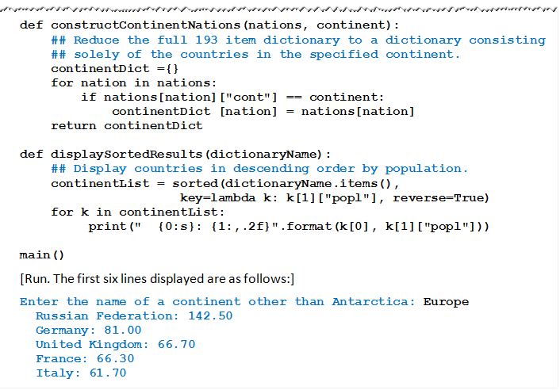
Extracting Ordered Data from a Dictionary
Example 6

Slide 23
Using Dictionary with Tuples as Keys
Given: file USpresStatesDict.dat a dictionary giving names of presidents and home states
Each key is a record of form
(last name), first name(s)).
Example 7: Program requests name of state, then displays presidents from that state ordered alphabetically

Slide 24
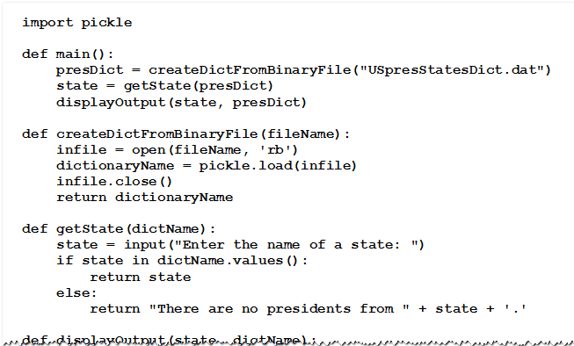
Using Dictionary with Tuples as Keys
Example 7

Slide 25
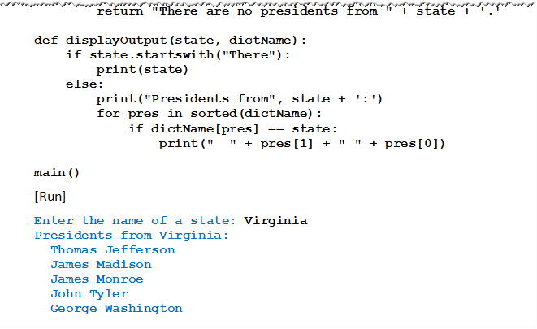
Using Dictionary with Tuples as Keys
Example 7

Slide 26


Dictionary Comprehension
Dictionaries can be created with dictionary comprehension.
Example
Dictionary comprehension can be used to extract a subset of a dictionary

Slide 27
END

